Slide 1
Introduction to Data Visualization
Kazutaka Takahashi
kazutaka@uchicago.edu
Research Computing Center

Slide 2
Git depot for the files and today’s presentation:
https://github.com/takahashikazutaka/workshop-IntroDataVisualization/tree/master/2018Fall
(Will move to the following later)
https://github.com/rcc-uchicago/workshop-IntroDataVisualization/2018Fall

Slide 3
What is data visualization?
Creating appropriate and informative pictures of a dataset
Iterative exploration of data

Slide 4
Visualization Definitions
Data Visualization
Broad term for visual representations of any data
Scientific Visualization (Contact me or Teodora at RCC for this type)
always about physical objects
using data with an inherent spatial component
E.g., wind tunnel vector data or three-dimensional (3D) medical images

Slide 5
Visualization Definitions
Information Visualization (I mainly focus this type this and the next two workshops)
Typically involve abstract, non-spatial data
Usually do not have inherent geometries by which to map information
E.g., financial data or document collection
Geographic Information Visualization (GIS)
Involve spatial data
Contain analysis of spatial data or tag location (and time) specific data

Slide 6

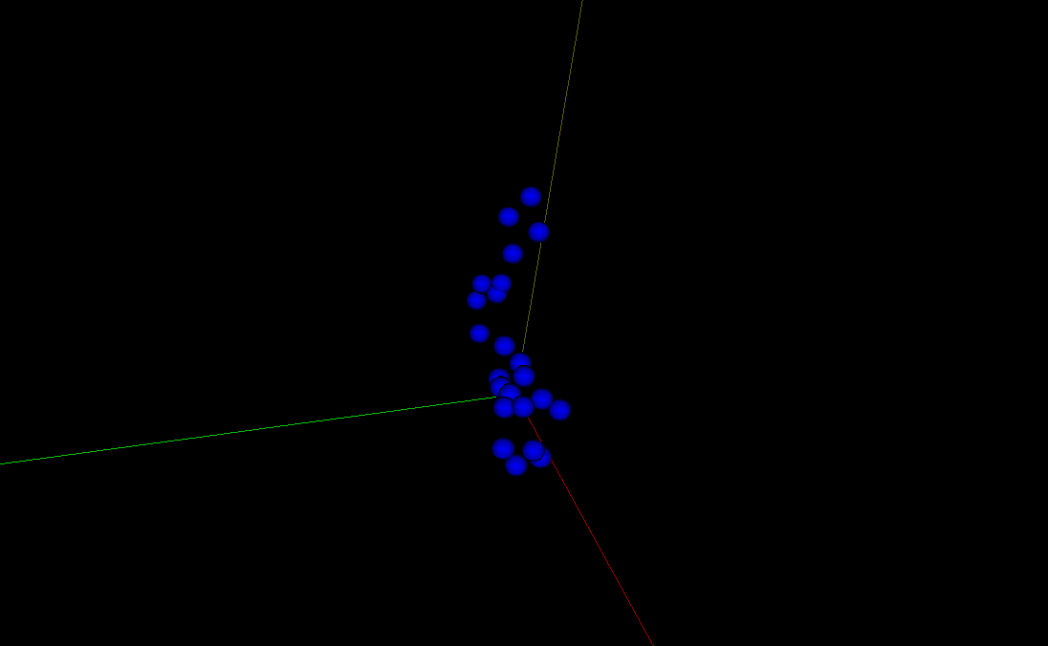
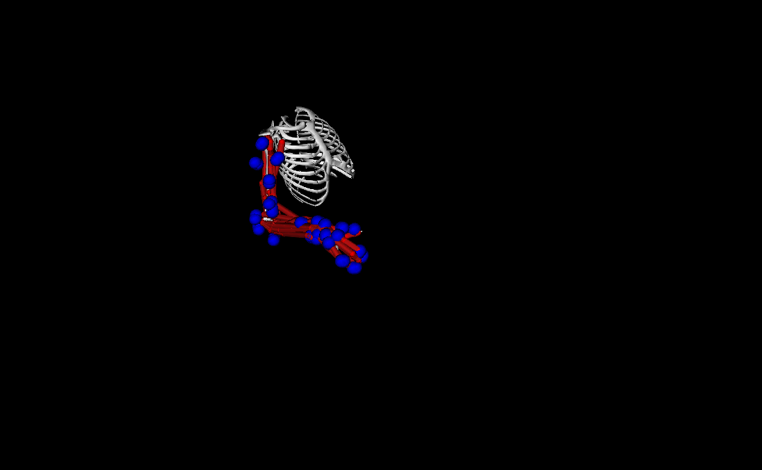
Scientific Visualization at RCC

Slide 7
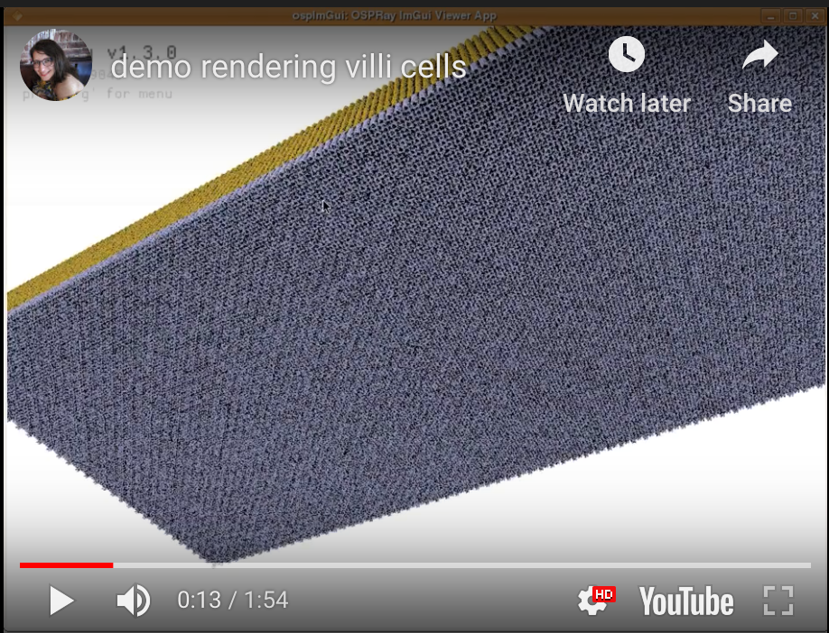
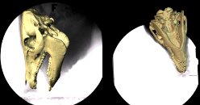
Scientific Visualization at RCC
https://youtu.be/Zgc6lKeLSsE
XROMM (various animal models available)
U Chicago by Taka and others from RCC with Prof. Ross from Department of Organismal Biology and Anatomy
VISUALIZING VILLI CELLS INSIDE HUMAN INTESTINE U Chicago by Dora from RCC with Department of Surgery,

Slide 8
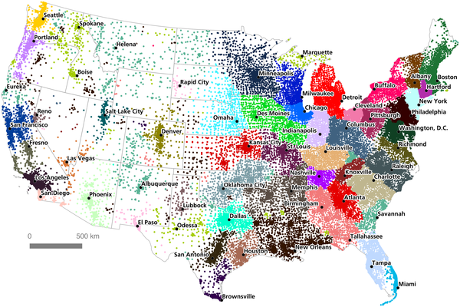

An Economic Geography of the United States: From Commutes to Megaregions
Dash Nelson G, Rae A (2016) An Economic Geography of the United States: From Commutes to Megaregions. PLOS ONE 11(11): e0166083. https://doi.org/10.1371/journal.pone.0166083
https://journals.plos.org/plosone/article?id=10.1371/journal.pone.0166083

Slide 9
Information Data Visualization - Why is this important?

Slide 10
“I keep saying that the sexy job in the next 10 years will be statisticians”
Hal Varian, Chief Economist Google
Statisticians will never have a sexy job. Data-powered storytellers will.

Slide 11
Visualization -> “Sanity” Check Statistics -> Quantify the “hunch”
Visualization != Sexy Pictures
Visualization -> Story telling (with your message)

Slide 12
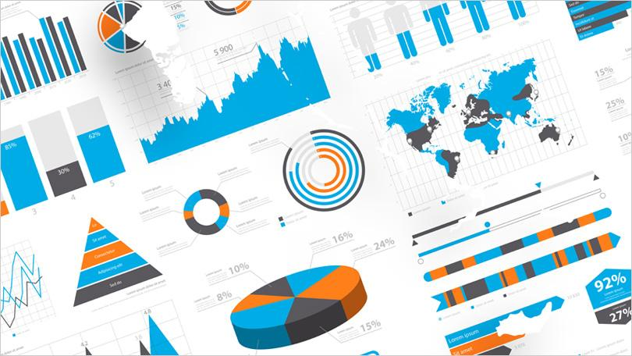
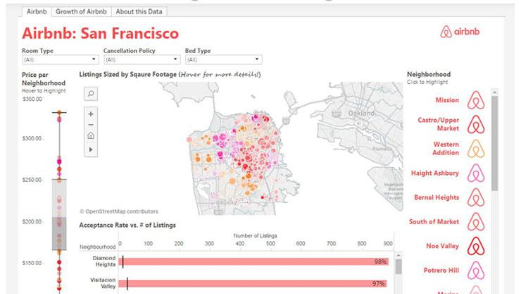
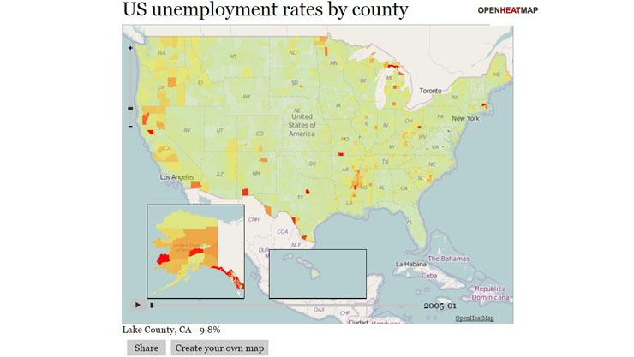
Visualization tools are everywhere
And most of them are for free!
https://www.pcmag.com/article/347315/10-free-data-visualization-tools

Slide 13
For Non-Developers/Coders: A few examples of free tools not requiring any coding:
Datawrapper is an online tool for making interactive charts.
Tableau Public is perhaps the most popular visualization tool which supports a wide variety of charts, graphs, maps and other graphics.
Raw defines itself as ‘the missing link between spreadsheets and vector graphics.
Timeline JS helps you create beautiful timelines without writing any code.

Slide 14
”Need” for Task-specific Visualization Design
LA Treinish, Task-specific visualization design, IEEE Computer Graphics and Applications, 1999
Generalized visualization systems are less suitable for environments with specific tasks and user needs
Prototypes help with defining/refining user needs
Iterative process of developing novel techniques to converge on meeting user needs
We may still want to design/code visualizations for your need!

Slide 15
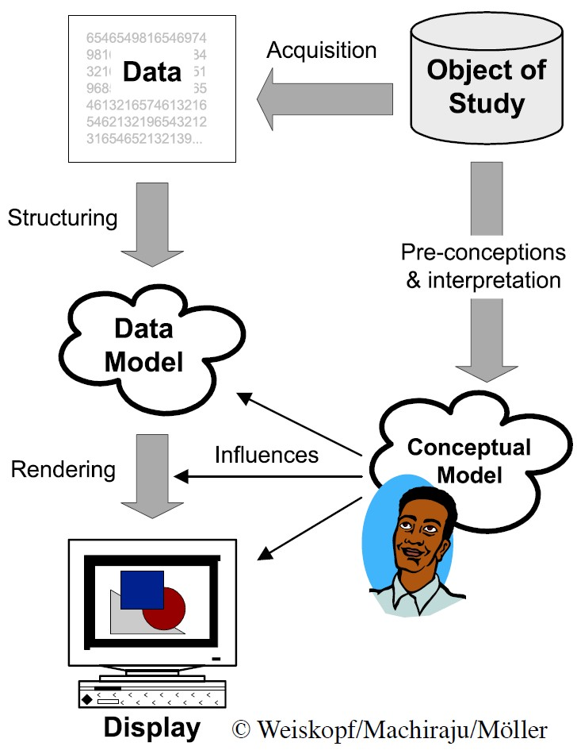
Overview of the Process

Slide 16
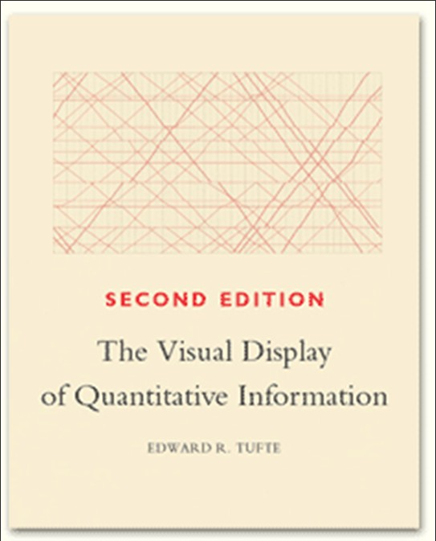
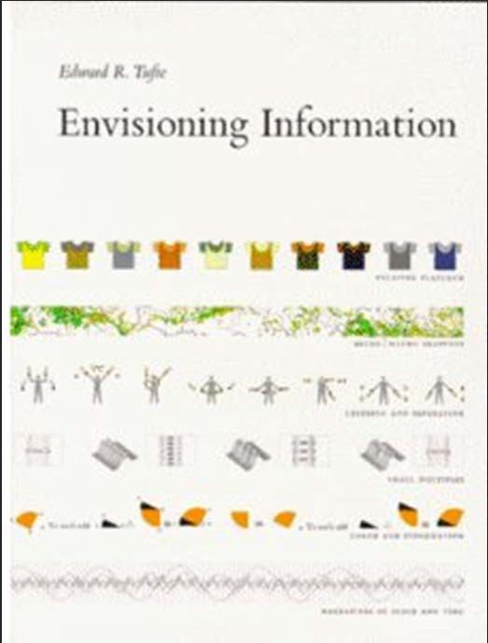
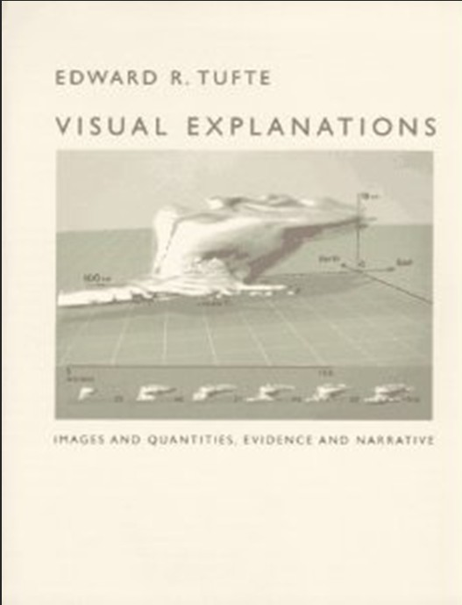
Design Excellence
“Well designed presentations of interesting data are a matter of substance, of statistics, and of design.”
– Edward Tufte

Slide 17
Tufte’s Principles for Graphical Integrity
The representation of numbers, as physically measured on the surface of the graphic itself, should be directly proportional to the numerical quantities represented.
Clear, detailed and thorough labeling should be used to defeat graphical distortion and ambiguity.
Write out explanations of the data on the graphic itself. Label important events in the data.

Slide 18
Tufte’s Principles for Graphical Integrity
In time‐series displays of money, deflated and standardized units of monetary measurement are nearly always better than nominal units.
Show data variation not design variation
The number of information‐carrying (variable) dimensions depicted should not exceed the number of dimensions in the data

Slide 19
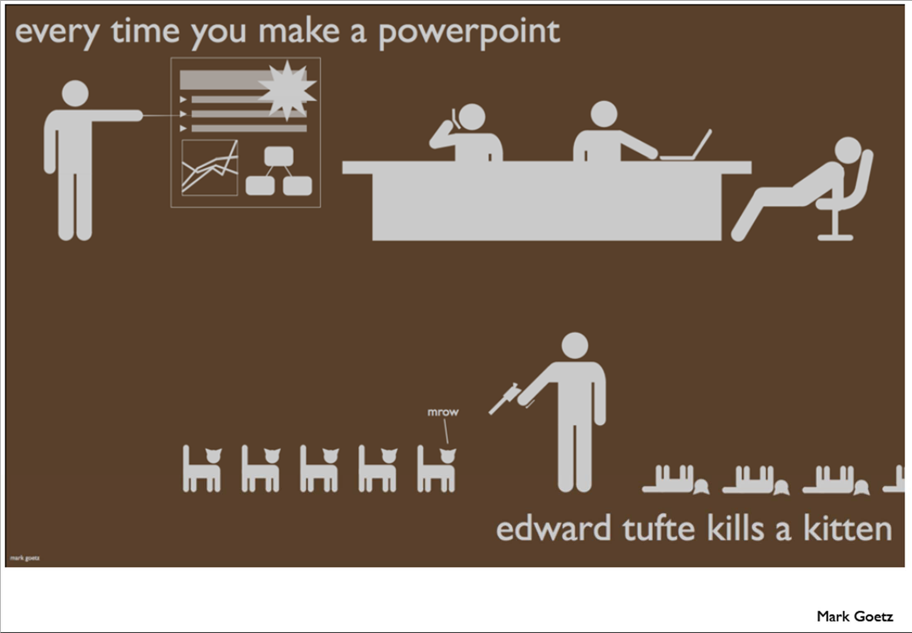

Slide 20
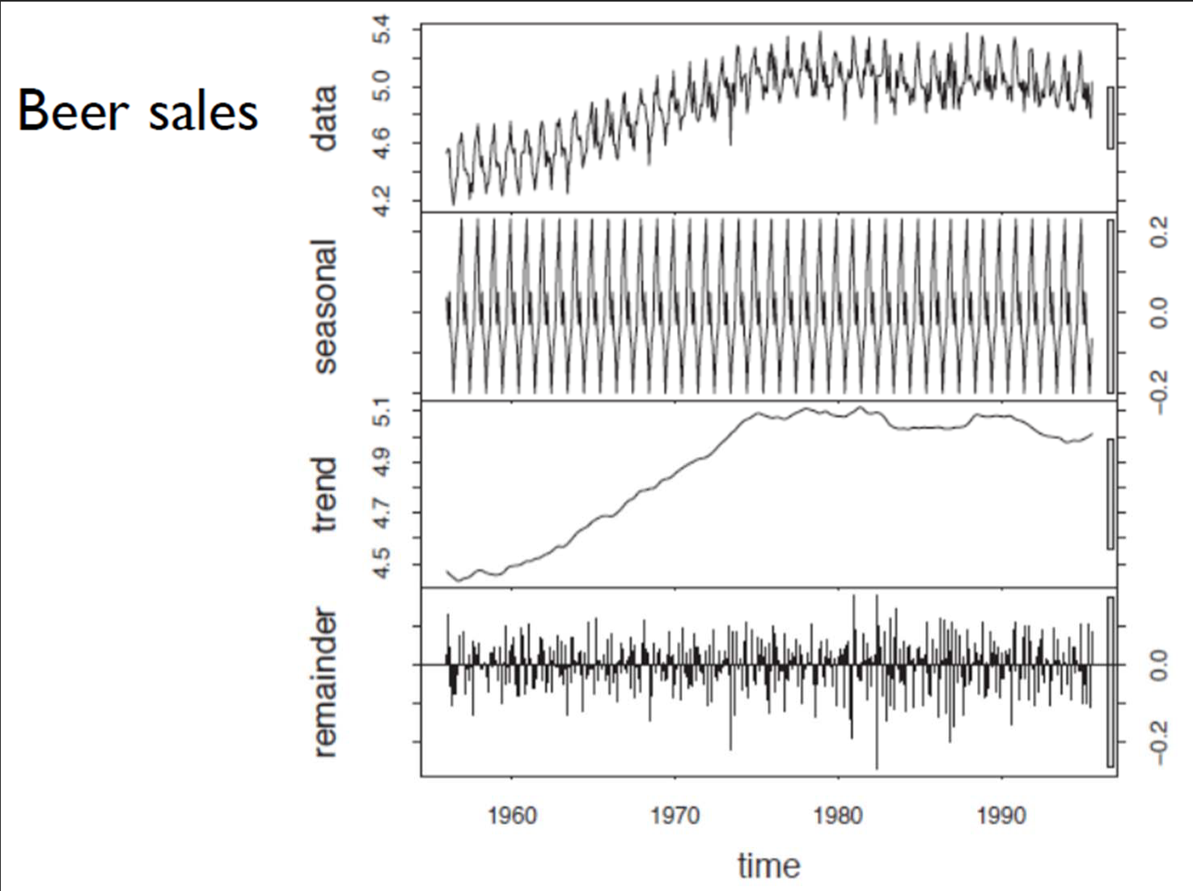
Design Principles
Use Decomposition

Slide 21
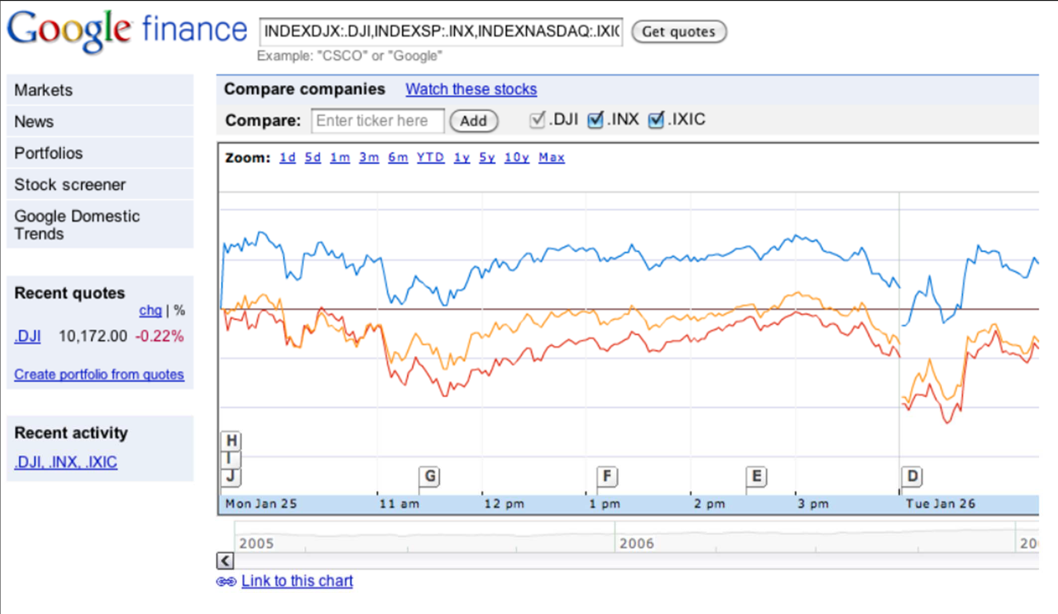
Hierarchical Display

Slide 22
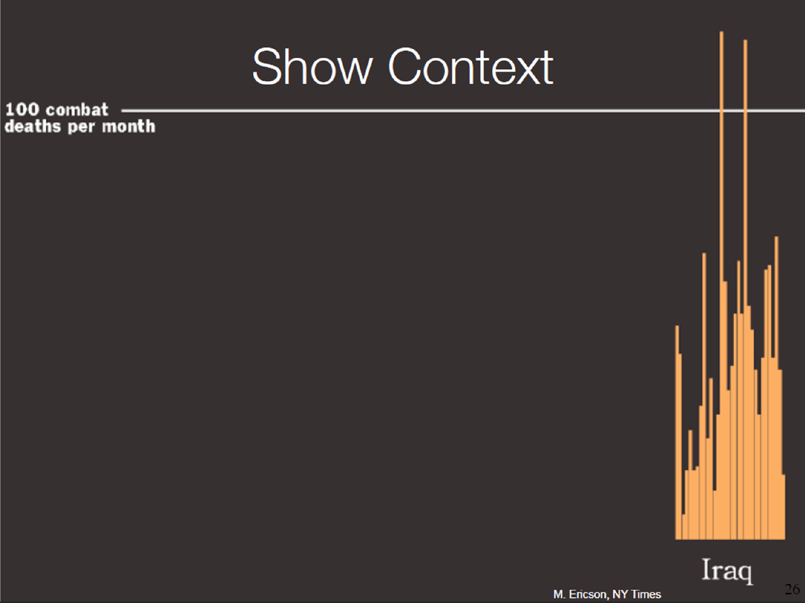

Slide 23
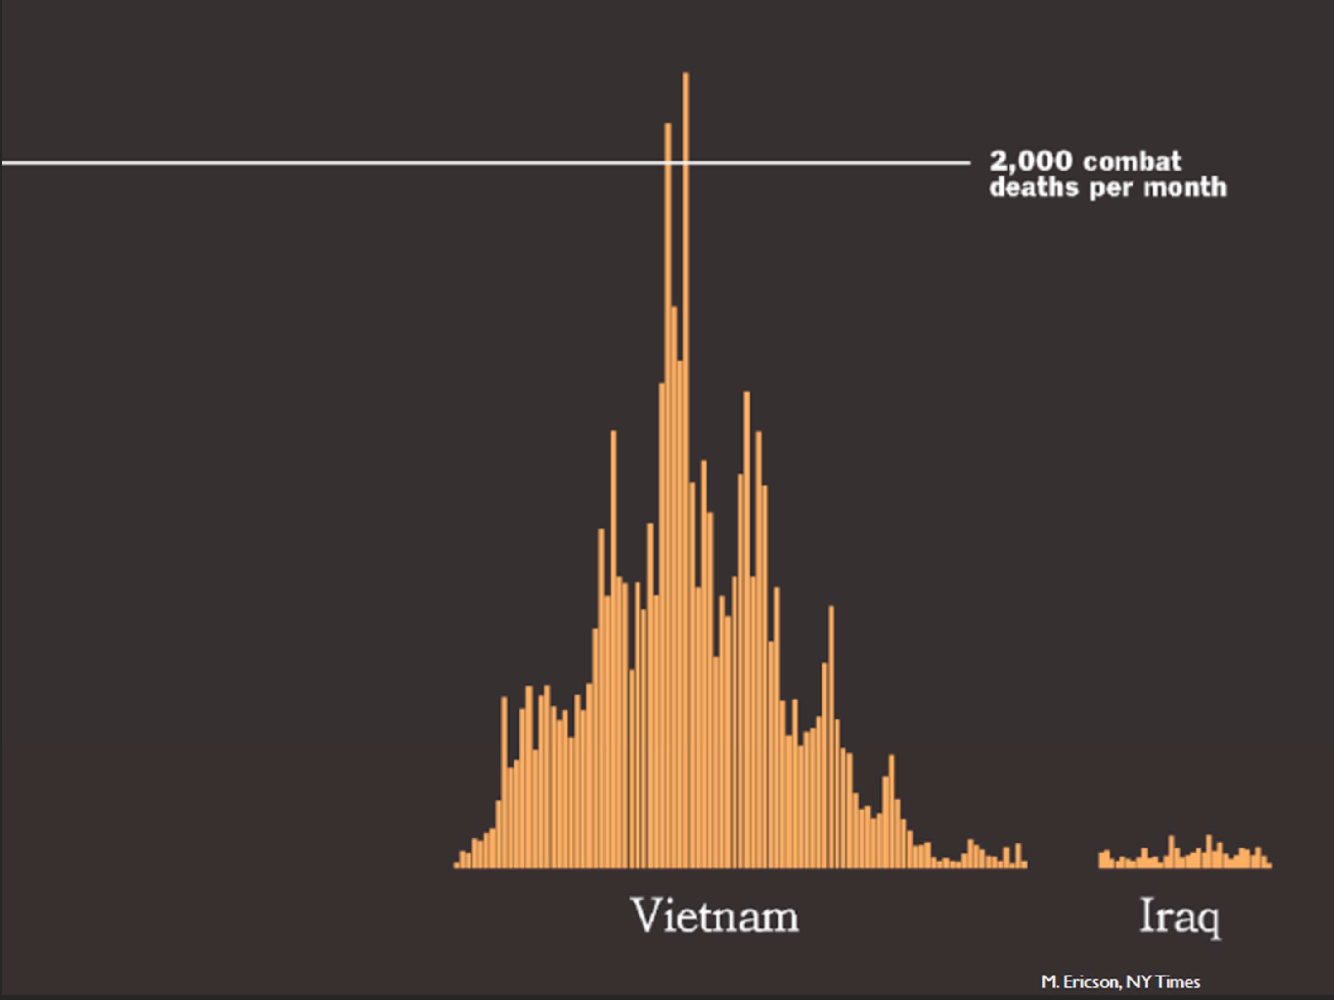

Slide 24
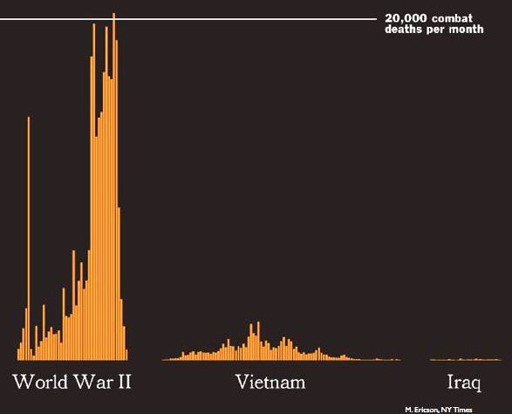
Visual Comparison

Slide 25
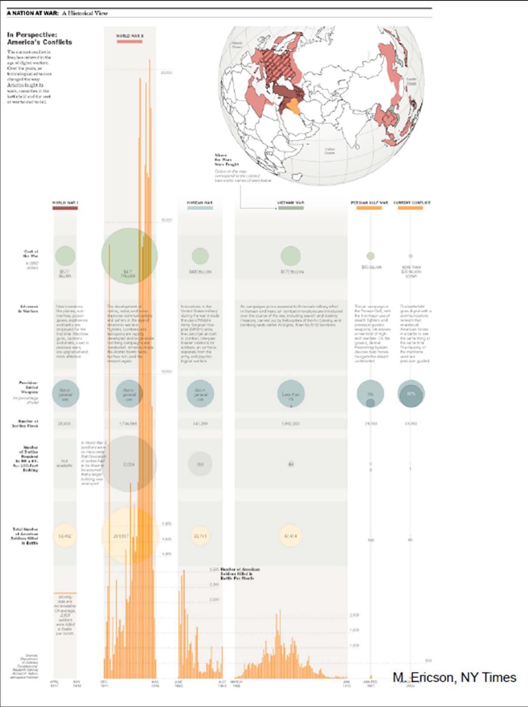
Embedding Data

Slide 26
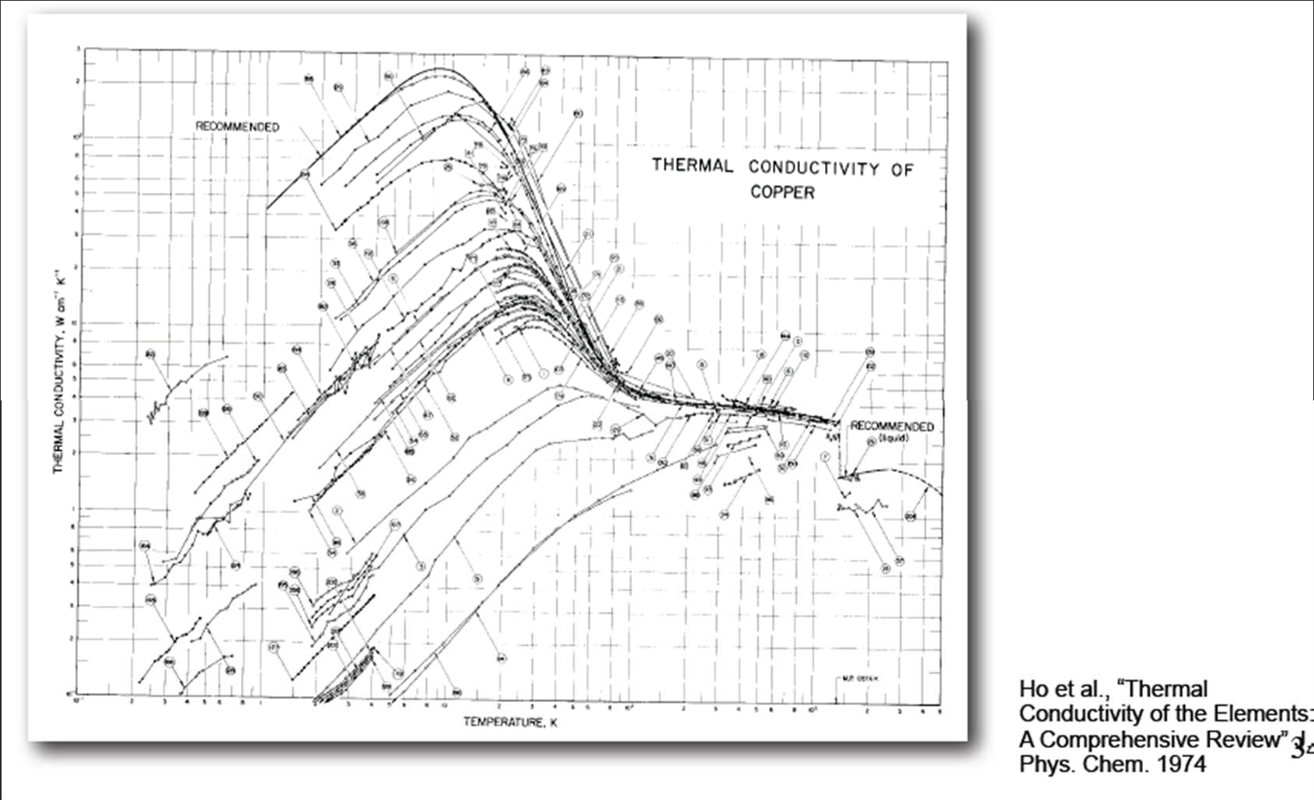
Data Density
Data density = number of entries in data array
area of data graphic

Slide 27
Fourteen Ways to Say Nothing With Scientific Visualization
Al Globus , Eric Raible, Fourteen Ways to Say Nothing With Scientific Visualization, Computer, v.27 n.7, p.86‐88, July 1994.
Negative rhetoric to convey message
Very interesting read
Thoughts evoking!
Good packages contain “classes” that enable us to say something meaningful

Slide 28
Fourteen ways..
Include a color legend – Class
Annotate – (Labeling and Annotation) – Class
Mention Error Statistics
Don’t smooth/alter your data
Provide performance comparisons
Be faithful to your representation – Class
Learn about the data domain‐

Slide 29
Fourteen ways..
Compare results with other vis techniques
Use visualization systems if available
Cite references to data – Class
Show multiple datasets to convince reader
Be fair to your vis technique (don’t show viewing angle that hides "blemishes")
Don’t try fancy graphics stunts to hide ugliness – Class
Be fair about extension to 3D ‐ Class

Slide 30
Visualization Pipeline
Simulation
Filtered
Data
Database
Raw Data
Mapping
Visualize
Acquisition
(scanners,
sensors, …)
Filtering
Rendering

Slide 31
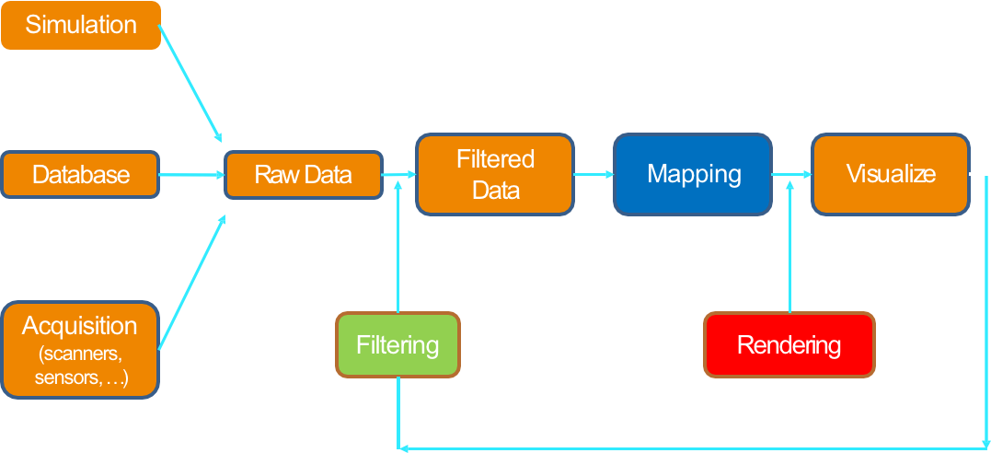
Filtering
Data input -> Data output
Data format conversion
Clipping/cropping/denoising
Slicing
Resampling
Interpolation/approximation
Classification/segmentation

Slide 32
Filtering (or parsing for text data)
Verma, K., M. Ranjan and P. Mishra. (2015) "Text mining and information professionals: Role, issues and challenges," 2015 4th International Symposium on Emerging Trends and Technologies in Libraries and Information Services
Over 90% of the information available is in unstructured and semi-structured forms
which is very difficult to search.
Text mining is a tool to help Information professionals
to find the relevant information and deliver to its users
Prescott, A. (2013) "Bibliographic records as humanities big data," 2013 IEEE International Conference on Big Data.
Superficially, bibliographic records appear to be a homogenous dataset
Examination reveals that records change through time
There are methods to disaggregate such data
Analogous to those used in some scientific disciplines

Slide 33
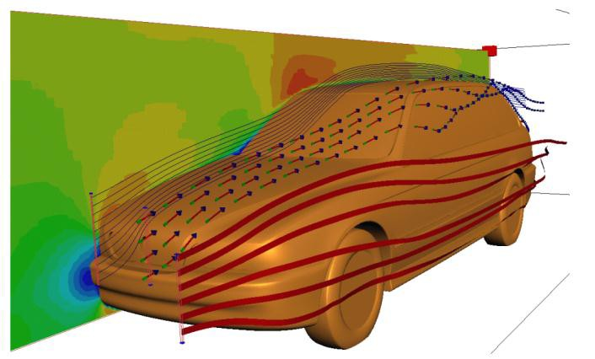
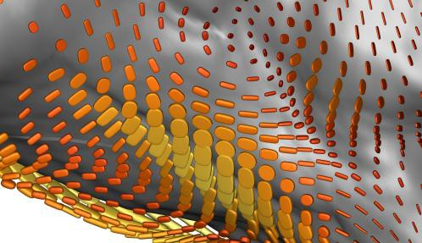
Mapping
Data input -> Graphical Primitives
Scalar field -> Surface, Lines
Vector field -> Vectors/Arrows/Streamlines
Tensor field -> Tensor glyphs/Ellipsoids
3D Field -> volume visualization
High dimensional data -> Map to 2D/3D
Image credits: SCI Utah, Daniel Weiskopf

Slide 34
Rendering
Render graphics primitives such as
Points
Lines
Surfaces
Volumes
With attributes such as
Color
Texture
Transparency

Slide 35
We will focus on Python
One of the most popular data science programming languages
Limit ourselves to use
Matplotlib
Bokeh
Holoview (especially in the context of network visualization)

Slide 36
matplotlib
Python’s version of Matlab plotting

Slide 37
How matplotlib Draws

Slide 38
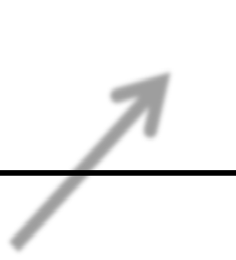
Figure object
Figure

Slide 39







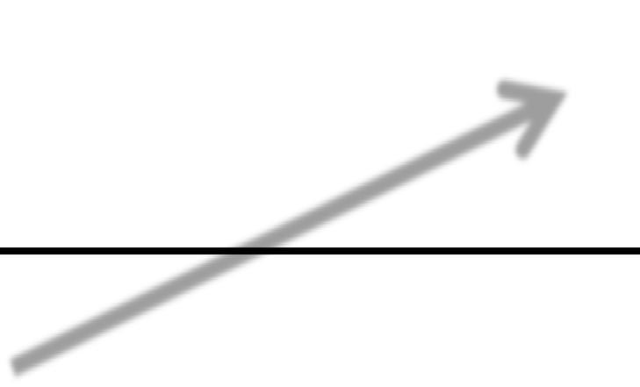
Subplot object
Draw in here
Subplot
Draw in her
e
Figure

Slide 40
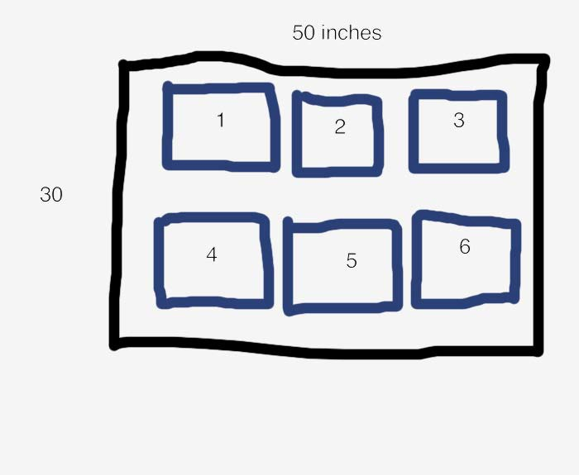
figure.add_subplot(2, 3, 1)
2
rows
3 columns

Slide 41

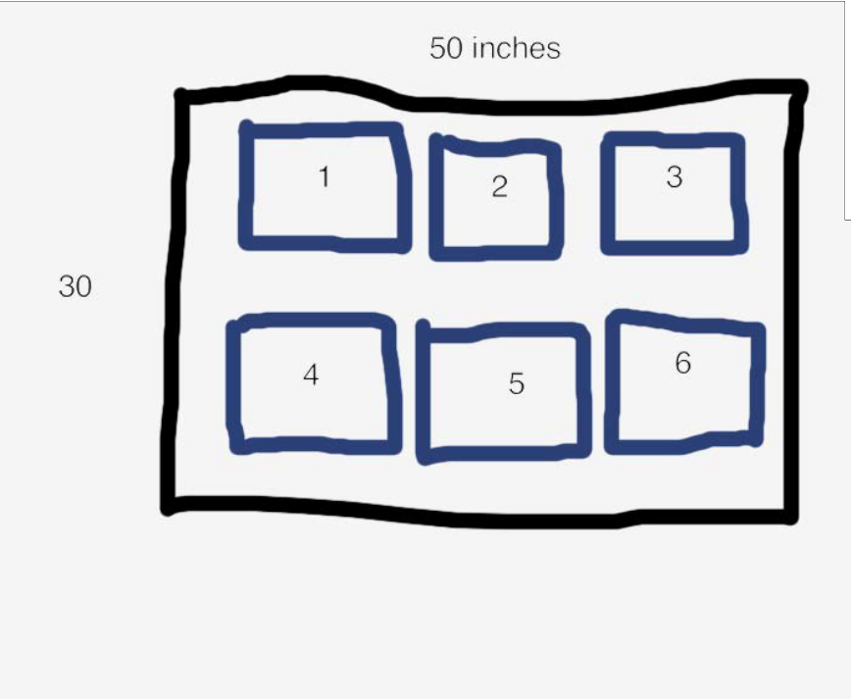

figure.add_subplot(2, 3, 1)
2
rows
3 columns

Slide 42
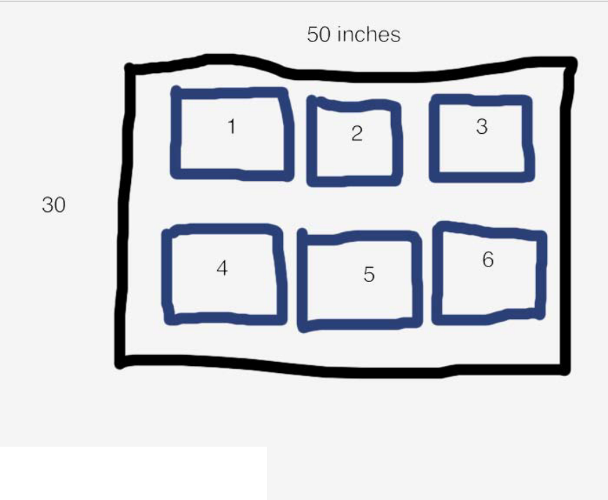



figure.add_subplot(2, 3, 1)
2
rows
3 columns
3

Slide 43
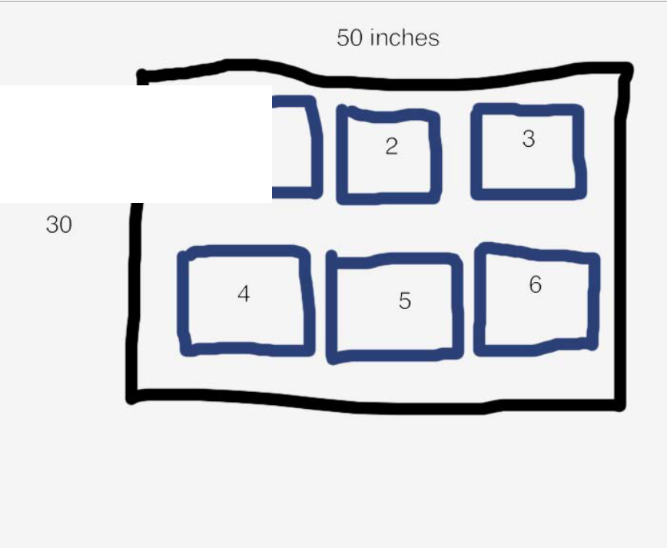

figure.add_subplot(2, 3, 1)
1
2
rows
3 columns

Slide 44
Charting Library
subplot.bar()
subplot.plot()
subplot.scatter()
subplot.boxplot()

Slide 45


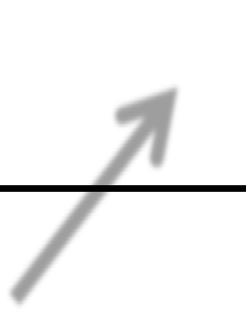
Lines
Subplot
Figure

Slide 46




Boxes
Subplot
Figure

Slide 47


Polygons
Subplot
Figure

Slide 48




Overlaps
Subplot
Figure

Slide 49


Overlaps
Subplot
Figure

Slide 50
Examples

Slide 51
Bokeh

Slide 52
Examples

Slide 53
Network visualization

Slide 54
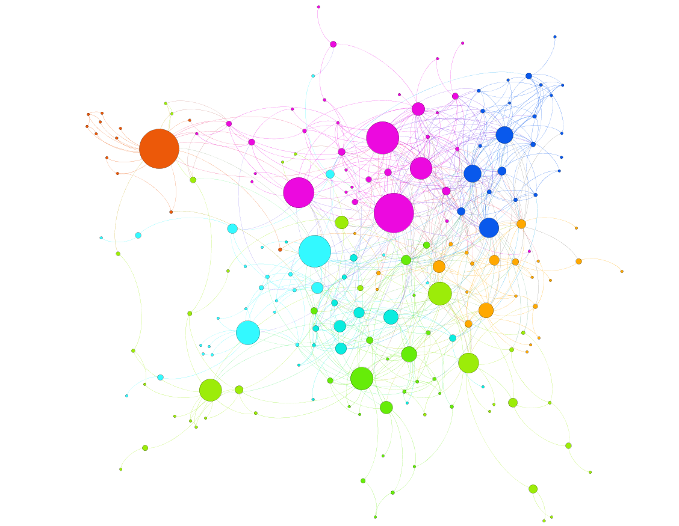
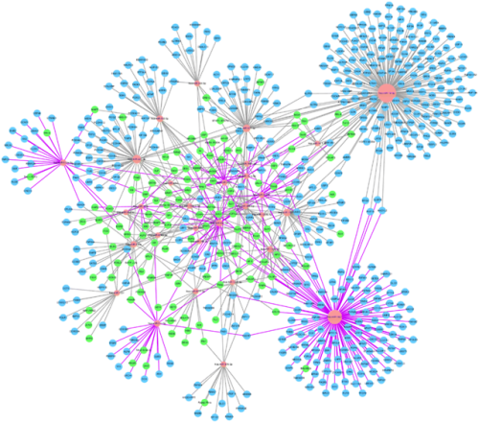
Many tools are available -
Cytoscape
Gephi
Facebook volunteer group network visualization in Gephi
By Nodus lab
MicroRNA expression profile of urinary exosomes in
Type IV lupus nephritis complicated by cellular crescent.
Li et al, J Biol Res (Thessalon). 2018 Dec; 25: 16.

Slide 55
Examples

Slide 56
Join the RCC's image analysis and visualization Slack team
Notes:
An image is not just an arbitrary function, these images are actually projections of 3D scenes, of 3D points

Slide 57
rcc-visualization.slack.com/signup

Slide 58



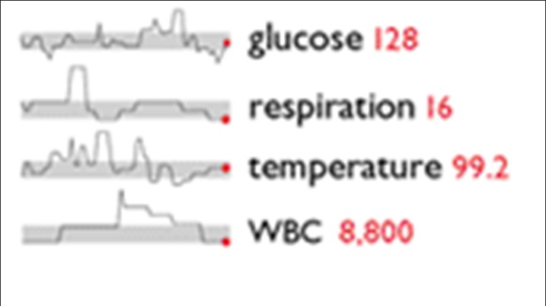

Data Density ‐ Sparklines
Sparklines are simple, word‐sized graphics
Show trends and allow users to understand the presented data better
Shows past 80 readings
Highlights specific data element
Shows normal range of glucose
Credits: Edward Tufte, Beautiful Evidence

Slide 59
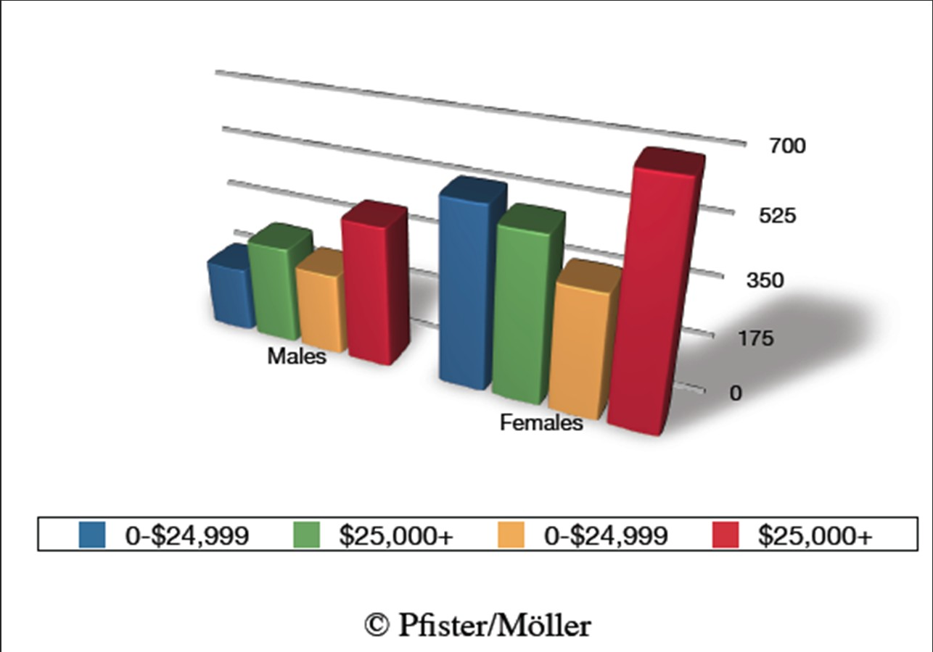
Maximize Data‐Ink Ratio
Data‐ink = ink used to show data
Data‐ink ratio = data‐ink/ total ink used

Slide 60
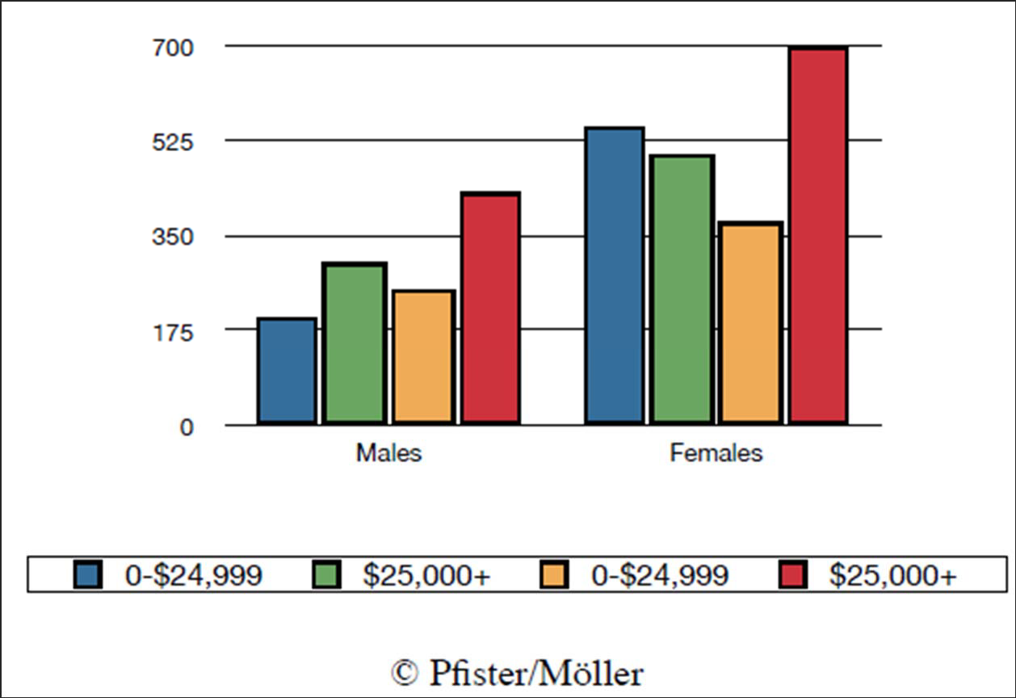
Maximize Data‐Ink Ratio
Data‐ink = ink used to show data
Data‐ink ratio = data‐ink/ total ink used

